Slide 1
Ingestion & Collection
Module 3

Slide 2
Agenda
What is DataFlow ?
What is NiFi
Architecture
NiFi Components
Example flows

Slide 3


Slide 4
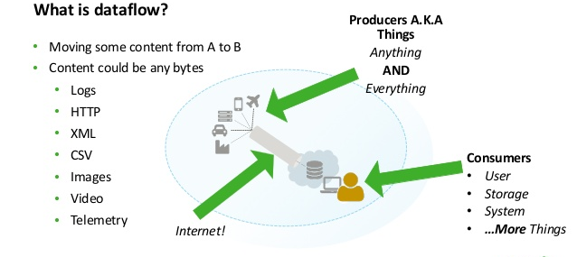

Slide 5
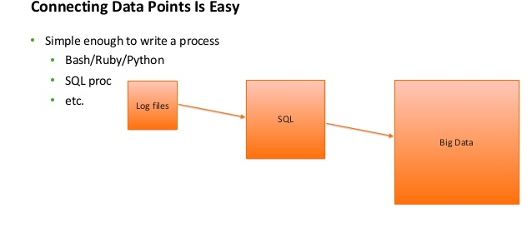

Slide 6
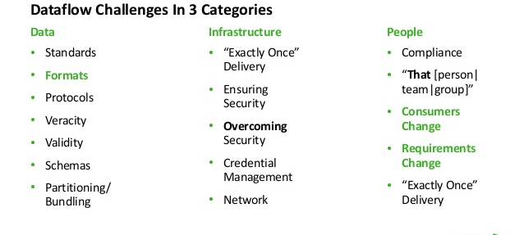

Slide 7


Slide 8
What is NiFi ?
Automates flow of data between systems
Inherently asynchronous, high throughput and natural buffering
Highly concurrent model without worrying about complexities
Resiliency: if a node is suddenly killed, it can continue without any loss of data when the node is brought up

Slide 9
Essential Terms
FlowFile
Processor
Connector (queues)
Flow Controller
Process Group
Notes:
Show various UI elements on NiFi deployment.
Only an overview of all components at this stage

Slide 10
Benefits
Guaranteed Delivery
Data buffering – back pressure & pressure release
Prioritized queuing
Visual Command and Control
Flow Templates
Data Provenance (lineage)
Scalable
Security: Encryption, Authentication & Authorization (not explored)

Slide 11
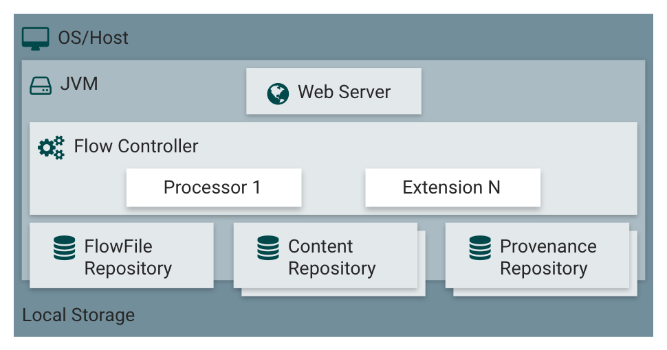
Architecture
Notes:
FlowFile repo – metadata of all current FlowFiles
Provenance repo – history of FlowFiles
Content repo – content of current and past FlowFiles -
FlowFile – hashmap in JVM memory, FlowFile repo - WriteAheadLog

Slide 12
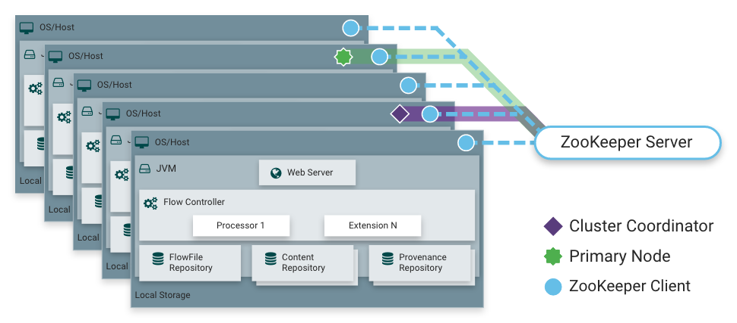
Clustering
Notes:
Zero Master Clustering
each node performs same task but on diff set of data
Nodes send heartbeat to cluster coordinator (elected)
UI can be connected on any node. Flow is in sync on all nodes.
Primary Node (elected) – Isolated Processors
Changes while node disconnected - Either no change or remove the node and change
Flow election on cluster startup:
upvoting and incompatible ones are disconnected.
‘empty flow’ winner only if all are empty
So admin can delete flow.xml.gz if its incompatible

Slide 13
Node failure
Nodes have no knowledge of FlowFiles queued on other nodes
If a node goes down, the FlowFiles queued on it will be in its repos
When its brought back online, it’ll continue processing.
Two options as of now to achieve node failure HA
Use RAID
Bring up a new node and use repositories from the down node.
Data HA across NiFi nodes is a future roadmap item.

Slide 14
Performance
IO
Depends on system configuration and jobs
For a typical out of the box default config, with a 50 MB/second read/write rate of disks in a server, NiFi reaches 100 MB/second or more of throughput
Linear growth expected for each physical partition and content repository added to NiFi
CPU
Flow controller can be configured for threads, settings depend on host system
RAM
Limited to memory afforded by JVM
https://nifi.apache.org/docs/nifi-docs/html/overview.html#performance-expectations-and-characteristics-of-nifi

Slide 15
Components in detail
Processor
Commonly used processors - https://nifi.apache.org/docs/nifi-docs/html/getting-started.html#what-processors-are-available
Connector
Process Group
Flow Controller
Provenance
Notes:
Show all tabs and configurations
Context sensitive help everywhere
Provenance – top level & component level, lineage graph

Slide 16
Adding more control through Flowfile attributes
Routing on basis of attribute (e.g. RouteOnAttribute processor)
Processor config on basis of attribute (e.g. PutFile processor)
Add/Update attributes (e.g. UpdateAttribute processor)
Read attributes (use NiFi Expression Language)

Slide 17
NiFi Expression Language
${filename}
${uuid}
${‘Attribute name with space or $pec!@l characters’}
${filename:toLower():contains(‘r’)}
${attr1:equals(${attr2})}
https://nifi.apache.org/docs/nifi-docs/html/expression-language-guide.html

Slide 18
Other NiFi elements
Templates – Export, Import, Instantiate
Top level menu
Summary, Counters, Controller settings, Cluster
Controller Services – scope, creating, enabling, disabling

Slide 19
Practical learnings
DONE file
Generalizing deployment
NiFi with Load Balancer / HAProxy
UI can be accessed on any node - but would you want to change UI url ?
Remote Process group’s endpoint can be any node - but what that node fails ?
ListenXXX component on primary node - what happens to client if node fails ?

Slide 20
NiFi flows in action
sample-app flow
Schema registry usage
Transit pattern tutorial
Remote Process group
Load balancing using NiFi

Slide 21
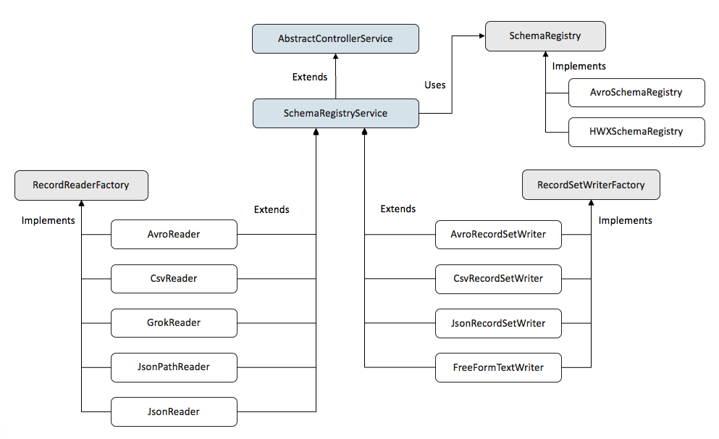
Schema Registry In Nifi

Slide 22
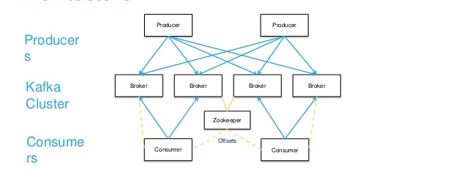
Apache kafka

Slide 23
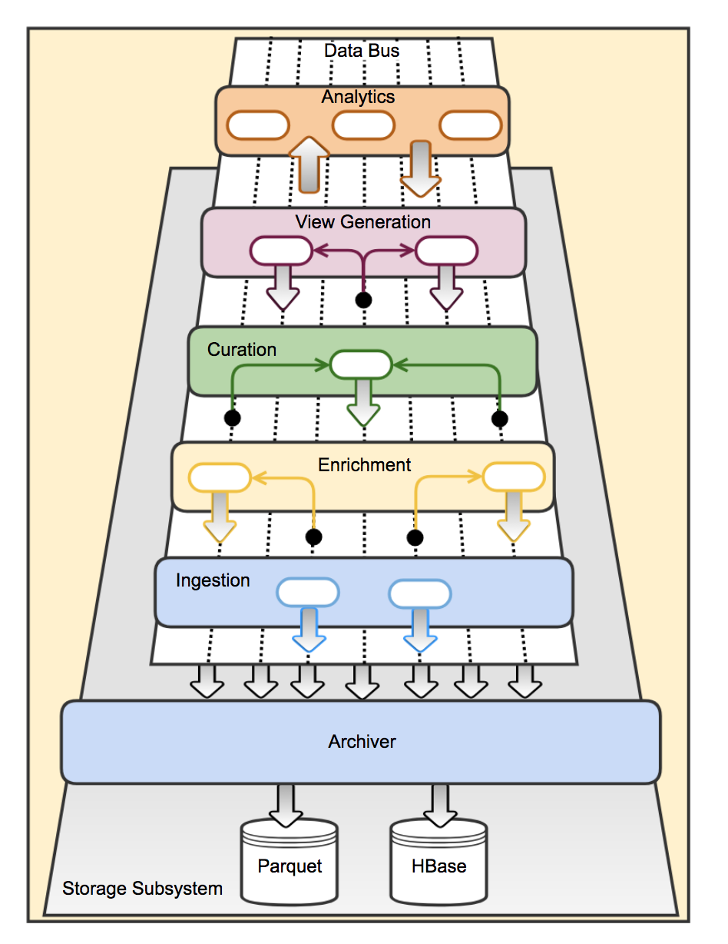
Kafka Used As DataBus

Slide 24
NiFi : SampleApp

Slide 25
Goal
The goal of this project is to demonstrate how a typical big data application can be built using the Guavus provided core libraries and easily deployed to run on Guavus Reflex Platform.
In this section, we focus on ingestion and collection of data using NiFi.

Slide 26
SampleApp: revisit
This application demonstrates a simple use case of retrieving Airport delay data from FlightAware WebService as {time, airport, temperature, delayDuration} and then finding the Anomalous points within this data set.
Here, anomalous points represent those data sets which completely deviate from the regular pattern seen for a particular airport.
Such data sets can be highlighted for taking further actions like investigating reasons for un-expected delays caused at any given airport and taking prompt corrective action.

Slide 27
Application Phases
The application can be divided in the following phases:
Ingestion
Store
Processing
Enrichment
Anomaly Detection
Serve
Deploy
In the following section, we will decompose and talk about the implementation of each phase.

Slide 28
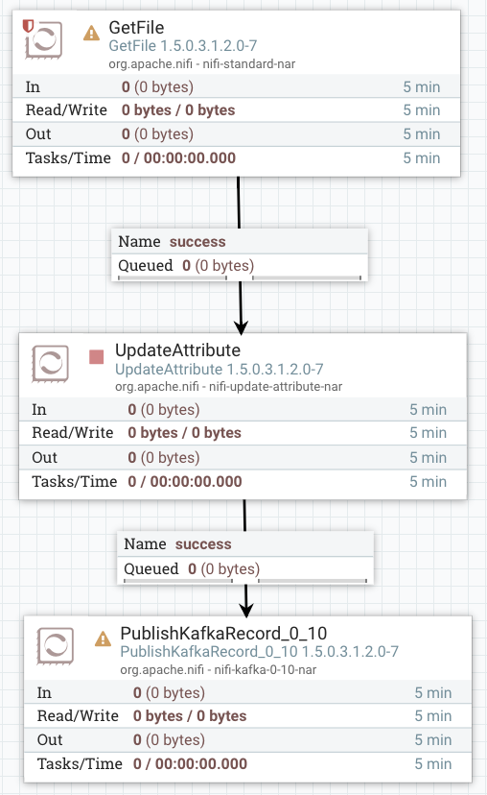
Big Picture: Ingestion

Slide 29
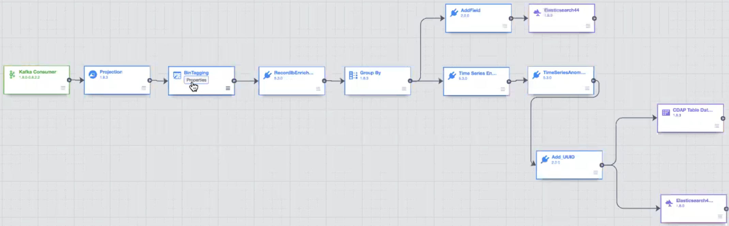
Processing & Serve

Slide 30
Deployment
Ansible Playbooks/Roles.

Slide 31
1. Ingestion
In Guavus platform, the data needs to be ingested into Kafka cluster (hosted on Guavus Platform nodes).
Therefore, any tool(like NiFi, Talend, Flume etc) being used to ingest data should support pulling data from CPE (or support handling of data being pushed to it by CPE) and writing it into Kafka.
We will be using NiFi for the Sample Application purposes. But you are free to choose any ingestion tool of your choice.
Notes:
CPE

Slide 32
NiFi Flow
Input data from CSV files continuously (Python Data Simulator).
The schema to decode this input data as CSV is read from HDP Schema Registry.
The same schema is used to serialize each record in Apache Avro Format and written into Kafka.
Note: Let’s demo for deep dive.

Slide 33
NiFi Flow (1)

Slide 34
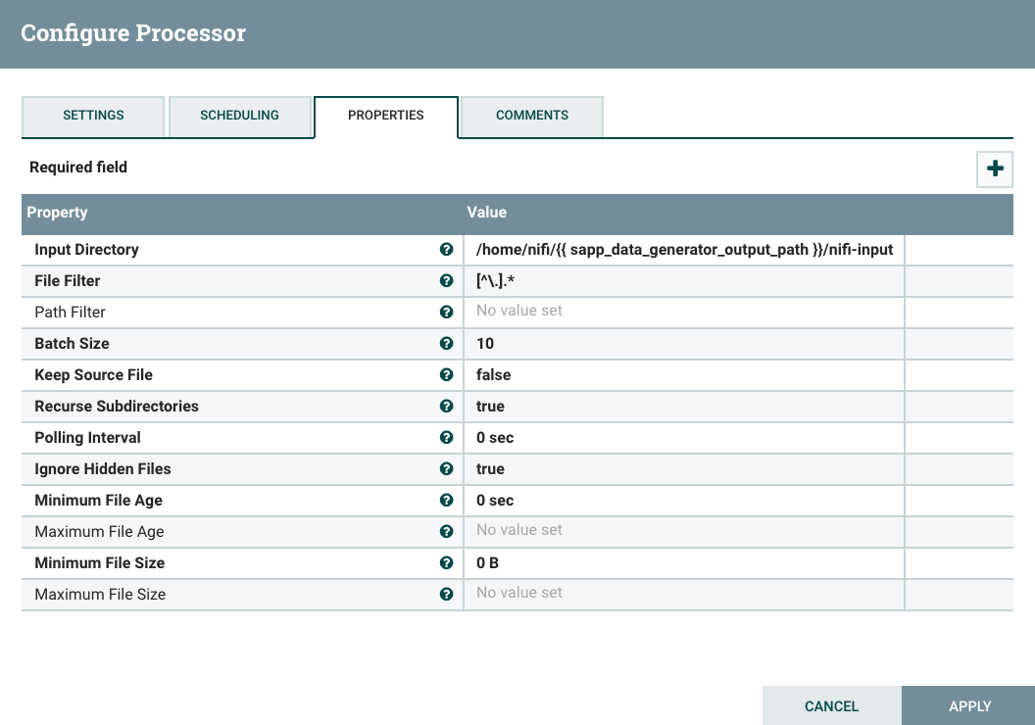
NiFi Flow (2): GetFile

Slide 35
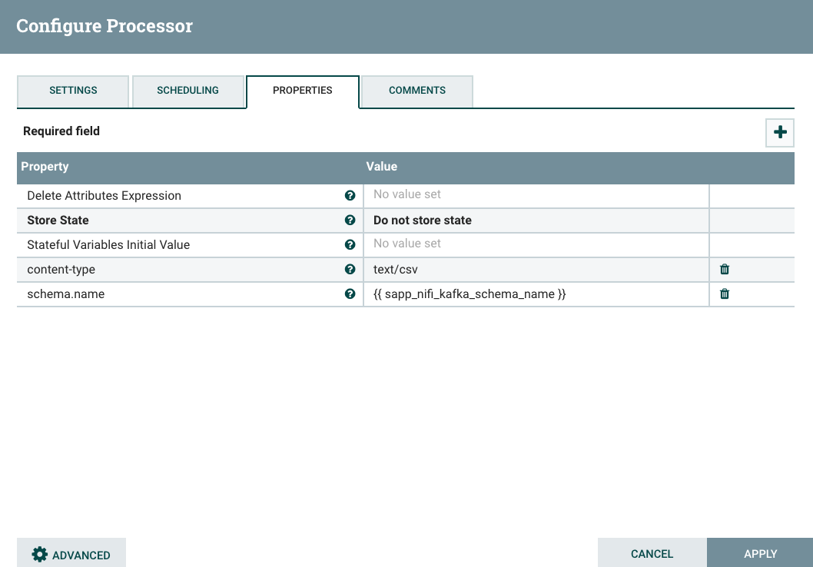
NiFi Flow (3): UpdateAttribute

Slide 36
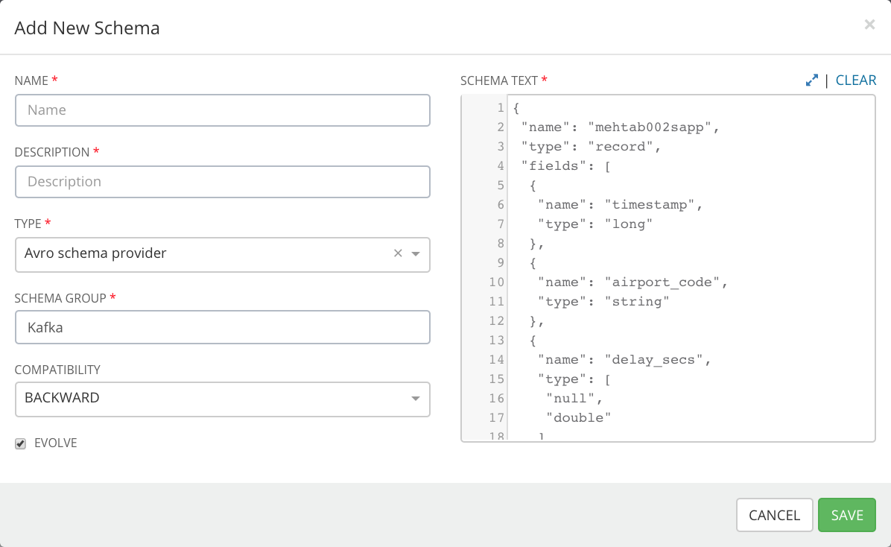
Schema Registry

Slide 37
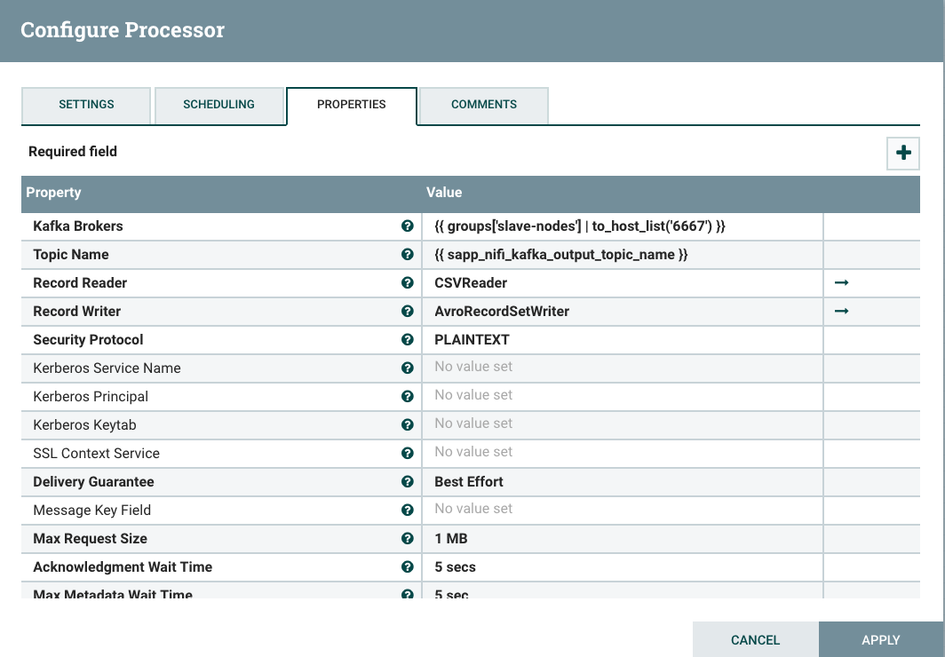
NiFi Flow (4): PublishKafkaRecord

Slide 38
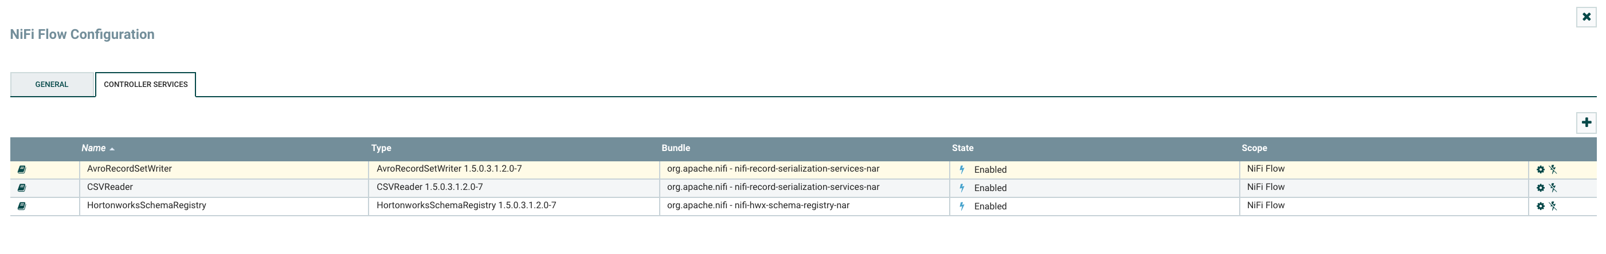
NiFi Flow (5): Controller Service

Slide 39
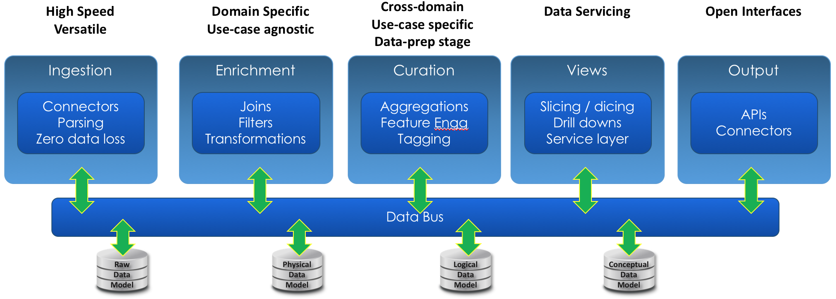
2. Store
Kafka is used as the Data Bus to store the ingested data for processing.
Notes:
https://www.confluent.io/blog/apache-kafka-vs-enterprise-service-bus-esb-friends-enemies-or-frenemies/

Slide 40
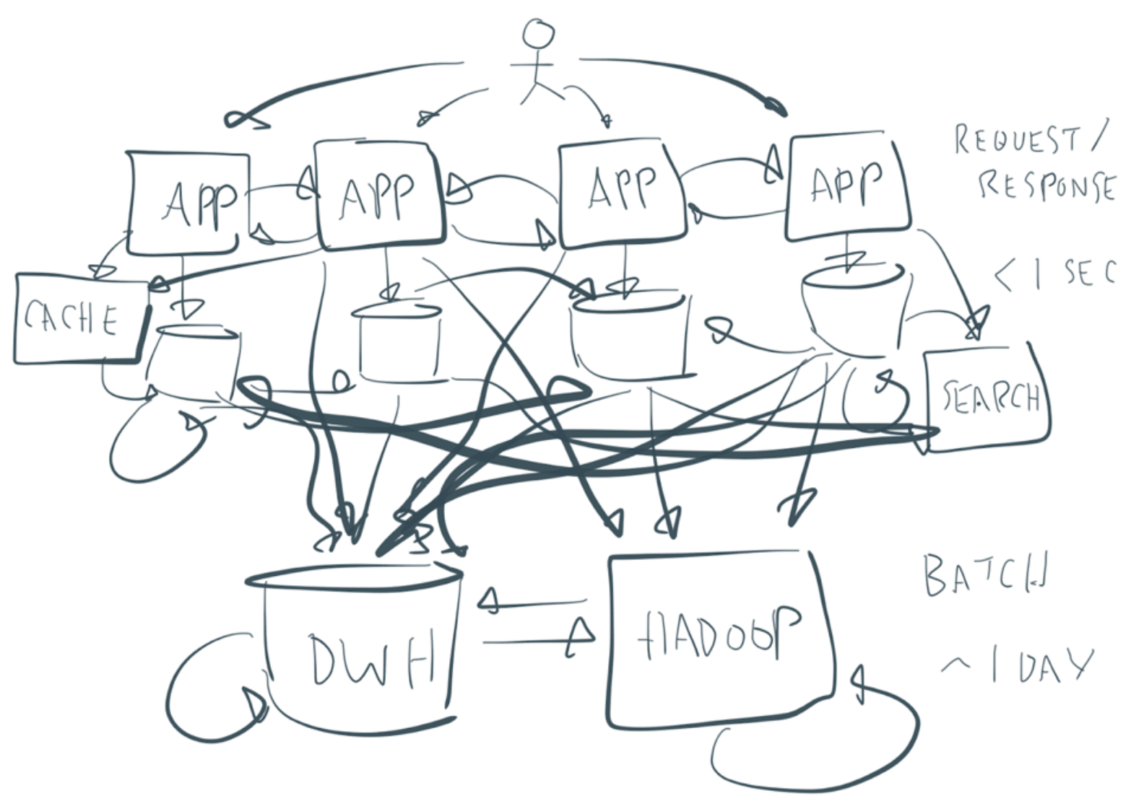
Enterprise Architectures
Notes:
https://www.confluent.io/blog/apache-kafka-vs-enterprise-service-bus-esb-friends-enemies-or-frenemies/

Slide 41
Benefits of Using Apache Kafka
Large and elastic scalability
Flexibility of architecture
Event-driven microservices
Openness without commitment to a unique technology or data format
Independent and decoupled business services
Multi-tenancy
Industrialized deployment

Slide 42
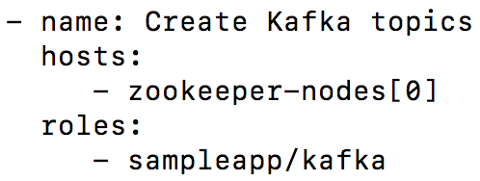
2. Store
So for the sample application, we would need create a Kafka topic.
We can achieve that in many ways but we will use Ansible for our application.
Ansible Playbook entry to create Kafka Topic

Slide 43
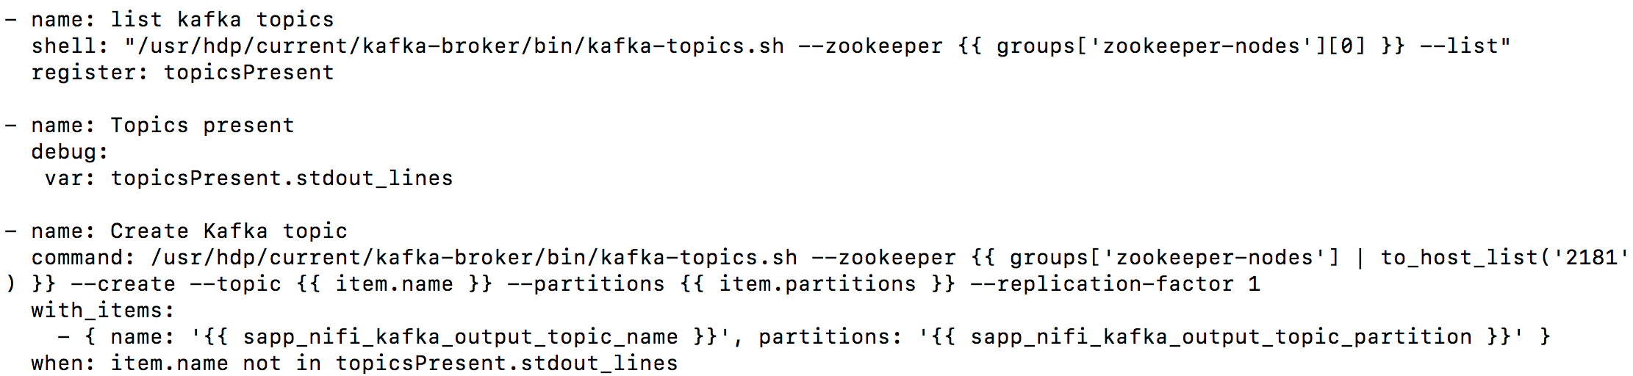
Role used by the Kafka playbook entry

Slide 44
Summary

Slide 45
References & Links
https://nifi.apache.org/docs.html
Good to go through: Overview, Getting Started, User Guide, Admin guide (Clustering)
As per need: Expression Language guide, Admin guide
https://nifi.apache.org/docs/nifi-docs/html/nifi-in-depth.html
https://hortonworks.com/tutorial/analyze-transit-patterns-with-apache-nifi/
https://community.hortonworks.com/content/kbentry/109629/how-to-achieve-better-load-balancing-using-nifis-s.html

